Slide 1
The Rady School of Management
MGT 103
Lecture #2
Organization & Strategy
Marketing Plans
11:00 – 12:20 p.m.
Wednesday
January 8th, 2020

Slide 2
Key Topics for Today – Lecture #2
Three kinds of organizations and the three levels of strategy in them.
2. Core values, Mission, Organizational culture,
Business, and Goals.
3. Marketing Dashboards and Marketing Metrics.
4. Discuss how an organization assesses

Slide 3
Key Topics for Today – Lecture #2 (cont.)
The three steps of the planning phase of the strategic marketing process.
Describe the four components of the implementation phase of the strategic marketing process.
Discuss how managers identify and act on deviations from plans.

Slide 4
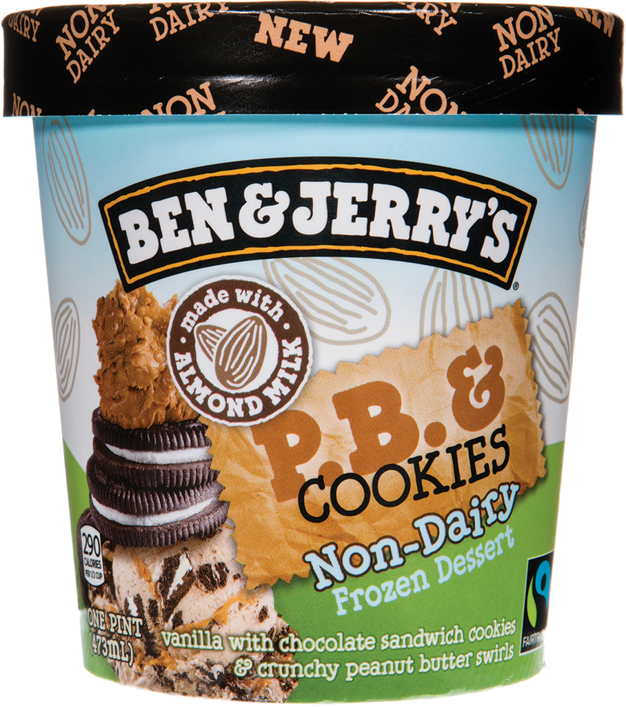

BEN & JERRY ON A MISSION: MAKE FANTASTIC, SUSTAINABLE, WORLD-CHANGING ICE CREAM
Mission: Product, Economic, Social
Free Cone Day
Fair trade
B-Corp Certification
PartnerShop Program
Ben & Jerry’s
Website
© Rafael Ben-Ari/Alamy

Slide 5
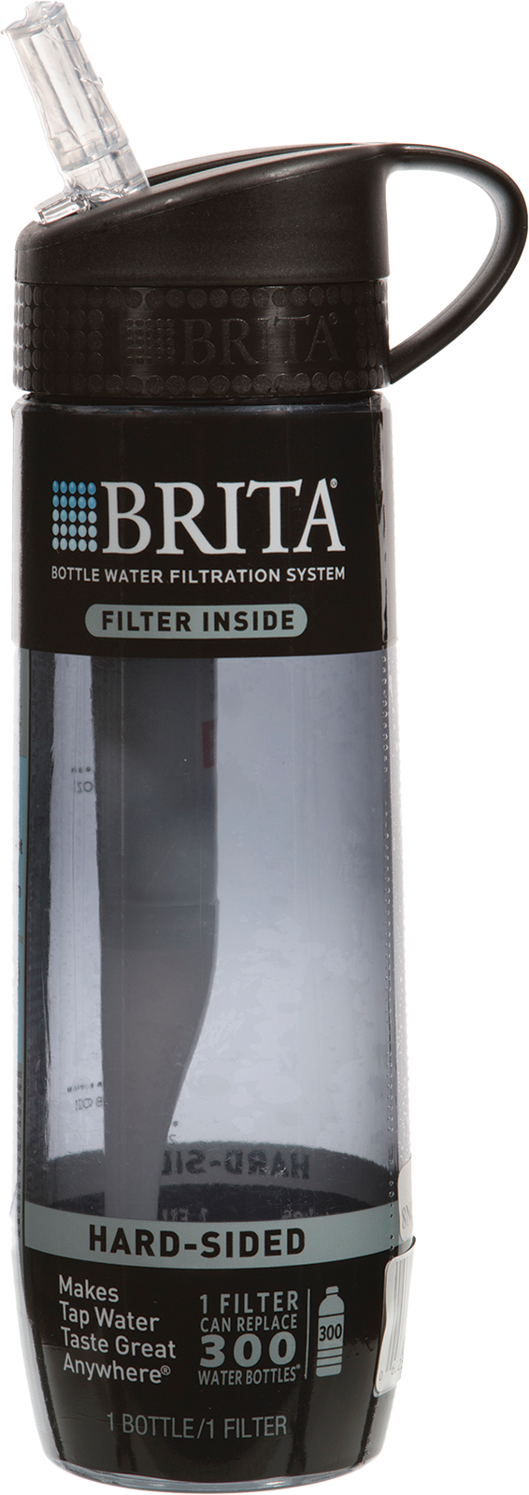
TODAY’S ORGANIZATIONS KINDS OF ORGANIZATIONS
Organization Offerings
1. For-Profit Organization (Business Firm)
2. Nonprofit Organization
3. Government Agency
4. Industry (trade association)
© Rafael Ben-Ari/Alamy

Slide 6
MAKING RESPONSIBLE DECISIONS Social Entrepreneurs Are Creating New Types of Organizations to Pursue Social Goals
Social Entrepreneurship to address important social needs and issues
Teach For America – 10,000 members teach 750,000 students each year

Slide 7

Teach for America

Slide 8
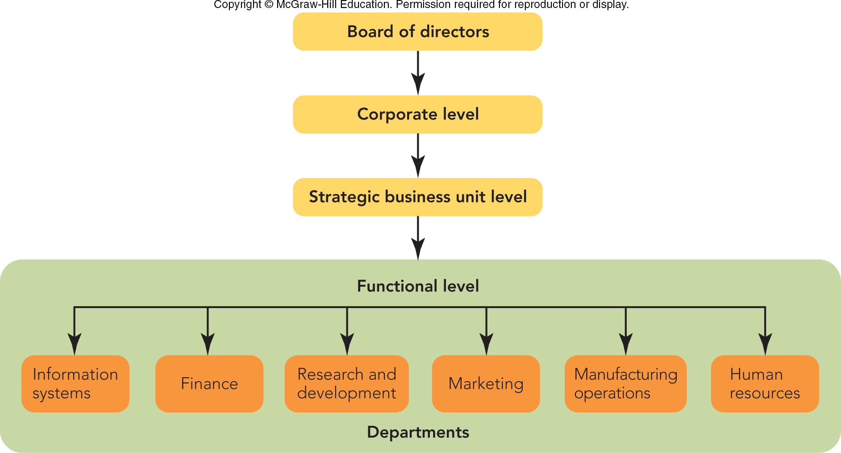
FIGURE 2-1 The board of directors oversees the three levels of strategy in organizations: corporate, business unit, and functional.
Jump to Appendix 1 long image description

Slide 9
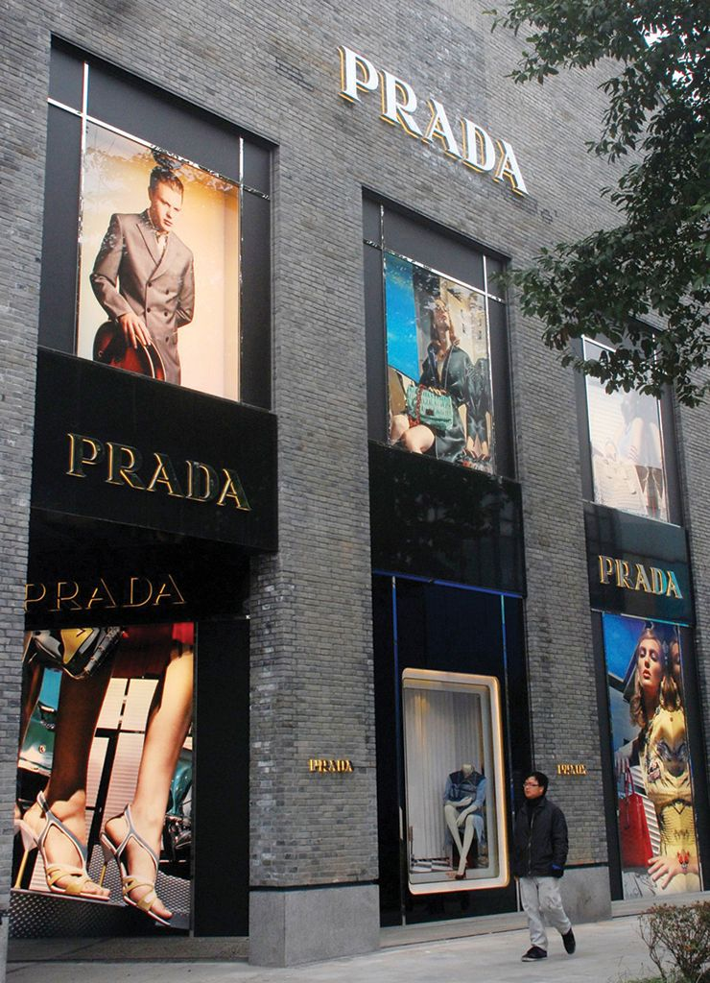
TODAY’S ORGANIZATIONS STRATEGY AND ORGANIZATIONAL STRUCTURE (1 of 2)
Can’t Be “All Things to All People”
Strategy
Corporate Level
Chief Marketing Officer (CMO)
Strategic Business Unit (SBU) Level

Slide 10
TODAY’S ORGANIZATIONS STRATEGY AND ORGANIZATIONAL STRUCTURE (2 of 2)
Functional Level
examples: shoe division, iPhone
Department Level
examples: finance, sales
Cross-Functional Teams
examples: finance, marketing, sales – all working together to launch a new products

Slide 11
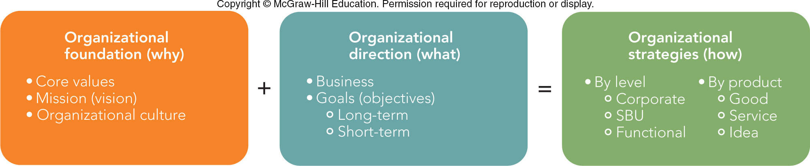
FIGURE 2-2 Visionary organizations use key elements to (1) establish a foundation and (2) set a direction using (3) strategies that enable them to develop and market their products successfully.

Slide 12
STRATEGY IN VISIONARY ORGANIZATIONS ORGANIZATIONAL FOUNDATION (WHY)
Core Values
Stakeholders
Mission or Vision
Mission Statement
Organizational Culture

Slide 13
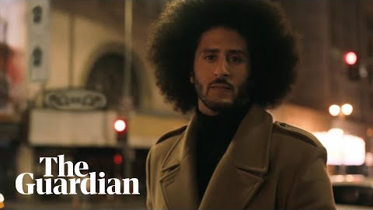
Nike

Slide 14

STRATEGY IN VISIONARY ORGANIZATIONS ORGANIZATIONAL DIRECTION (WHAT) (1 of 2)
Business
What do we do?
What business are we really in?
Business Model
© Digital Vision; Source: United Parcel Service of America, Inc.

Slide 15
STRATEGY IN VISIONARY ORGANIZATIONS ORGANIZATIONAL DIRECTION (WHAT) (2 of 2)
Goals or Objectives
Profit
Sales (dollars or units)
Market Share
Quality
Customer Satisfaction
Employee Welfare
Social Responsibility
Efficiency (nonprofit organizations)

Slide 16
STRATEGY IN VISIONARY ORGANIZATIONS ORGANIZATIONAL STRATEGIES (HOW)
Variation by Level
Corporate
SBU
Functional
Variation by Product (or Offering)
Product
Service
Idea

Slide 17
STRATEGY IN VISIONARY ORGANIZATIONS TRACKING STRATEGIC PERFORMANCE WITH MARKETING ANALYTICS
Marketing Dashboard
Marketing Metric
Data Visualization
Dundas

Slide 18
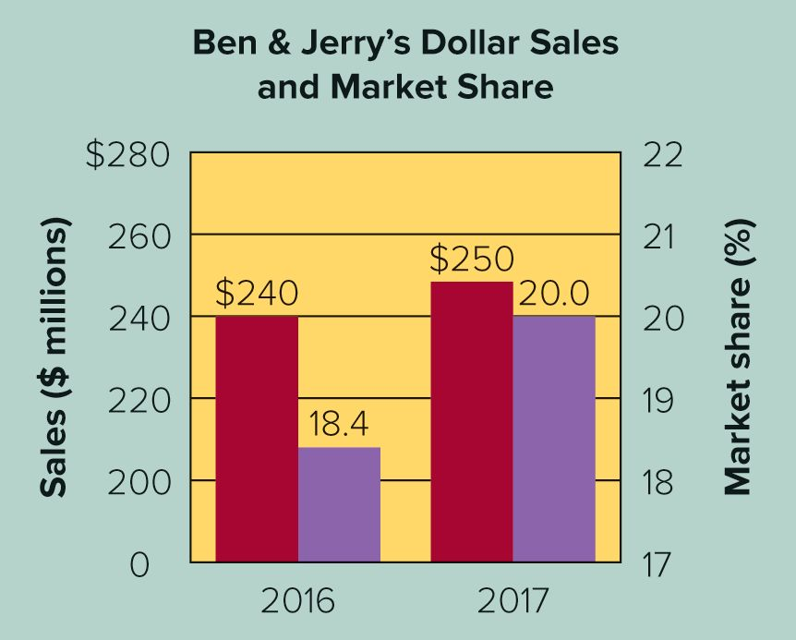
APPLYING MARKETING METRICS How Well Is Ben & Jerry’s Doing?
Dollar Sales and Dollar Market Share
Dollar Sales ($) = Average Price × Quantity Sold
Dollar Market Share (%) = Ben & Jerry’s Sales ($) ÷ Total Industry Sales ($)

Slide 19
SETTING STRATEGIC DIRECTIONS A LOOK AROUND: WHERE ARE WE NOW?
Competencies
Competitive Advantage
Customers
Competitors

Slide 20
SETTING STRATEGIC DIRECTIONS WHERE DO WE WANT TO GO? (1)
Business Portfolio Analysis (BCG Matrix)
Question Marks:
Low Share of High-Growth Market
Stars:
High Share of High-Growth Markets
Cash Cows:
Generates Large Amounts of Cash
Dogs:
Low Share of Slow-Growth Markets

Slide 21
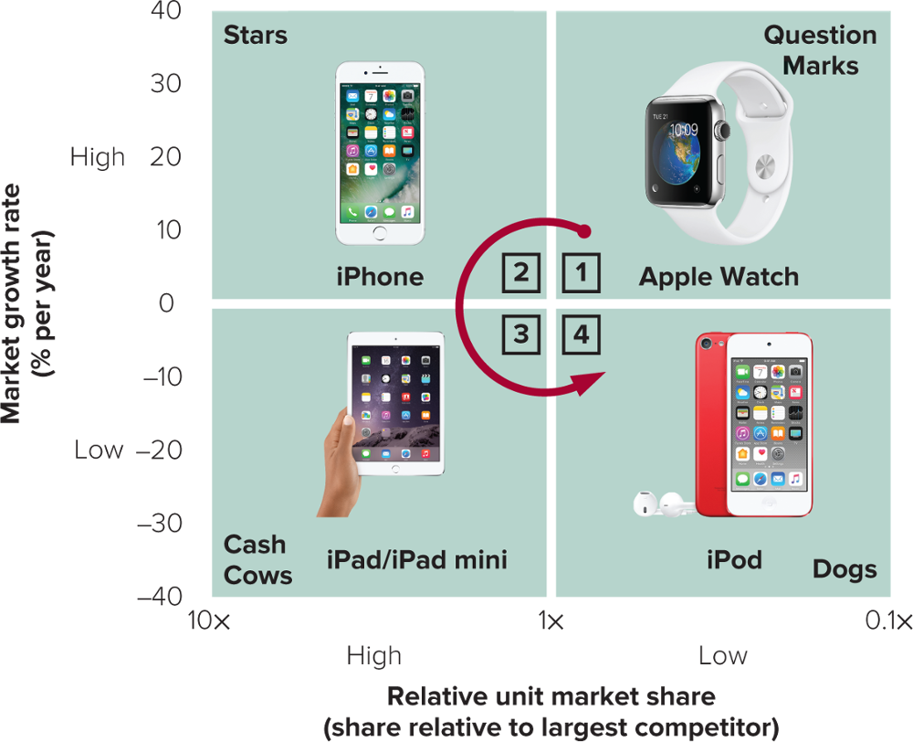
FIGURE 2-4 BCG business portfolio analysis for Apple’s consumer SBUs
Apple’s Website
All product photos: Source: Apple Inc.

Slide 22
SETTING STRATEGIC DIRECTIONS WHERE DO WE WANT TO GO? (2)
Diversification Analysis
Market Penetration:
Increase Sales of Current Product in Current Markets
Market Development:
Sell Current Products to New Markets
Product Development:
Sell New Products to Current Markets
Diversification:
Develop New Products to Sell in New Markets

Slide 23
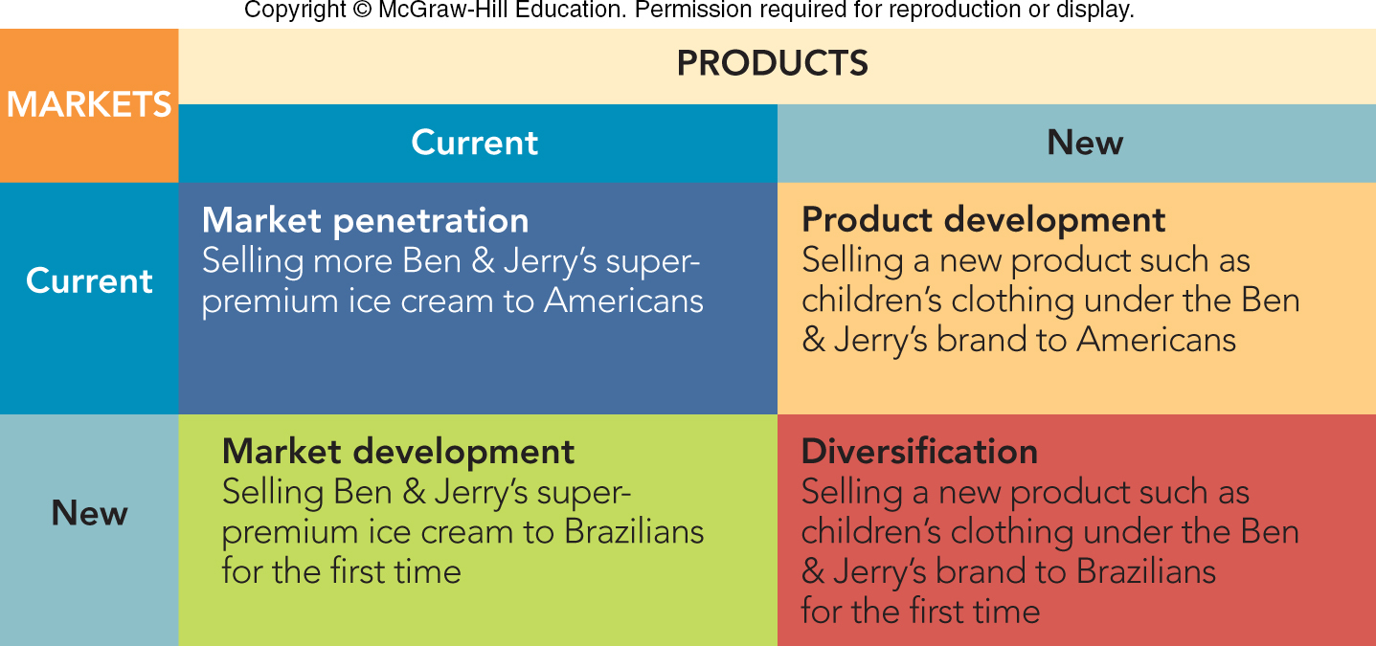
FIGURE 2-5 Four market-product strategies: alternative ways to expand sales revenues for Ben & Jerry’s using diversification analysis.
Jump to Appendix 5 long image description

Slide 24
THE STRATEGIC MARKETING PROCESS
Strategic Marketing Process
How do we allocate our resources to get to where we want to go?
How do we convert our plans into actions?
How do our results compare with our plans and do deviations require new plans?

Slide 25
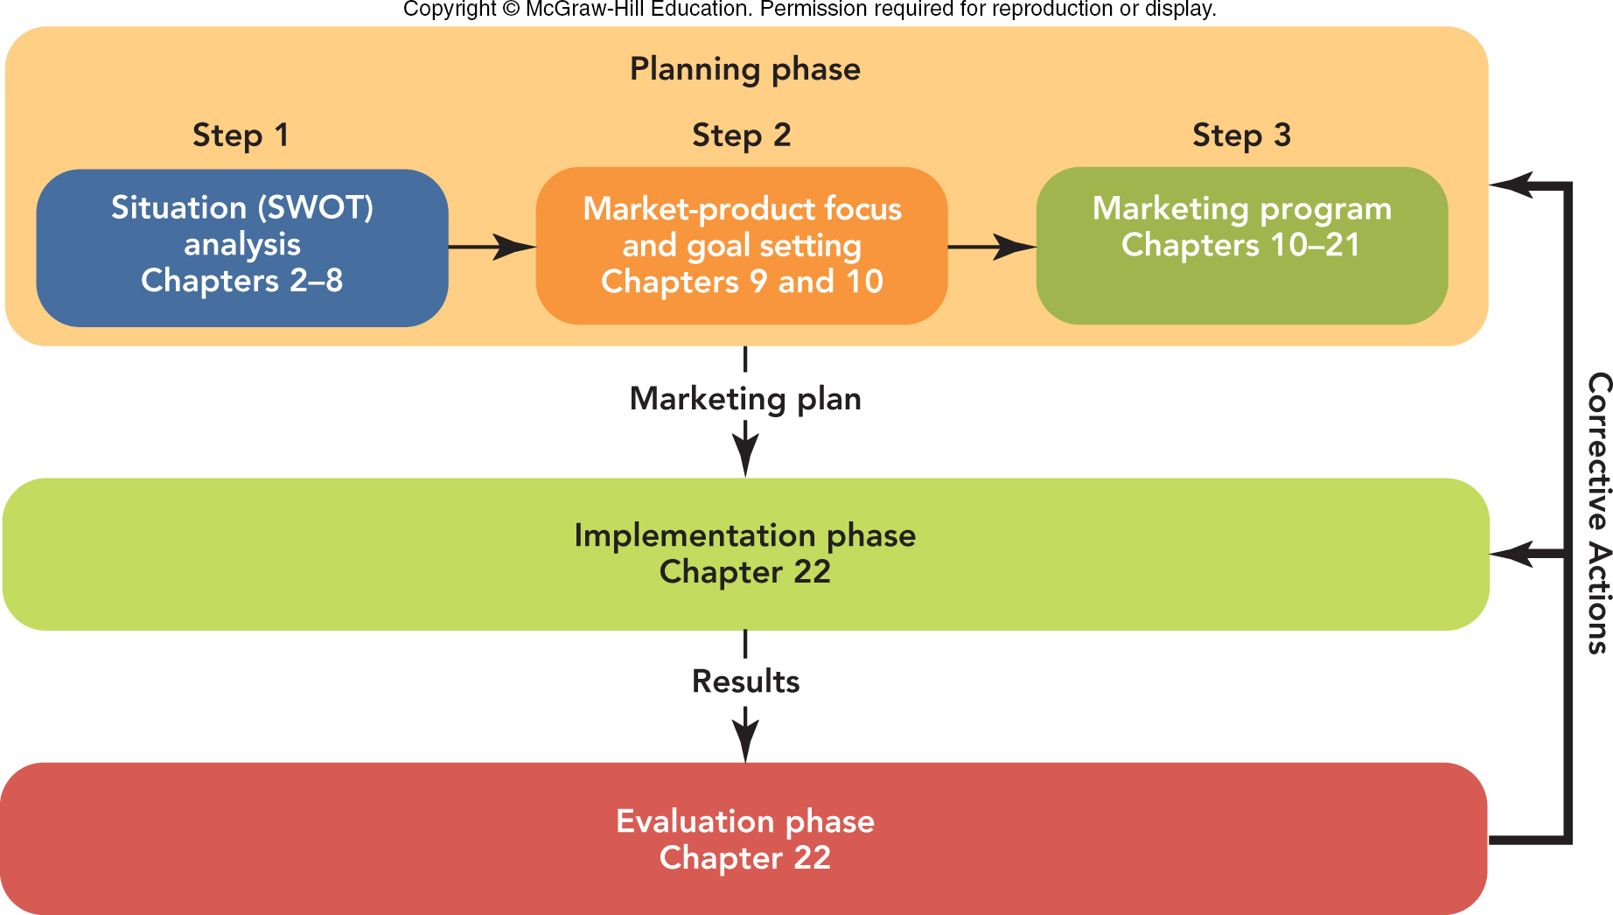
FIGURE 2-6 The strategic marketing process has three phases: planning, implementation, and evaluation.
Jump to Appendix 6 long image description

Slide 26
THE STRATEGIC MARKETING PROCESS THE PLANNING PHASE (1 of 5)
Step 1: Situation (SWOT) Analysis
Situation Analysis
SWOT Analysis
Strengths
Weaknesses
Opportunities
Threats

Slide 27
THE STRATEGIC MARKETING PROCESS THE PLANNING PHASE (2 of 5)
Step 1: Situation (SWOT) Analysis
SWOT Analysis Study
Identify Industry Trends
Analyze Competitors
Assess the Organization
Research Present and Prospective Customers

Slide 28
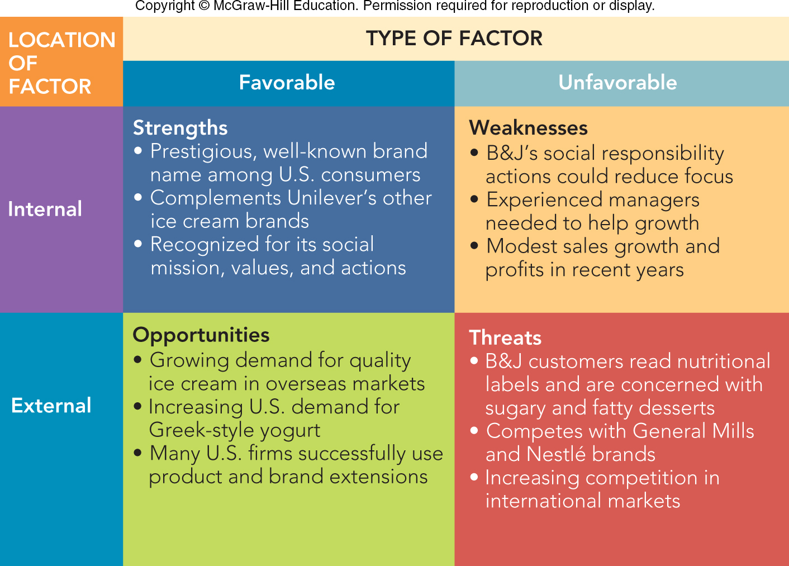
FIGURE 2-7 Ben & Jerry’s SWOT analysis that serves as the basis for management actions regarding growth.

Slide 29
THE STRATEGIC MARKETING PROCESS THE PLANNING PHASE (3 of 5)
Step 1: Situation (SWOT) Analysis
SWOT Analysis Actions
Build on a Strength
Correct a Weakness
Exploit an Opportunity
Avoid a Disaster-Laden Threat

Slide 30
THE STRATEGIC MARKETING PROCESS THE PLANNING PHASE (4 of 5)
Step 2: Market-Product Focus and Goal Setting
Market Segmentation
Points of Difference

Slide 31
THE STRATEGIC MARKETING PROCESS THE PLANNING PHASE (5 of 5)
Step 3: Marketing Program
Product Strategy
Price Strategy
Promotion Strategy
Place (Distribution) Strategy

Slide 32
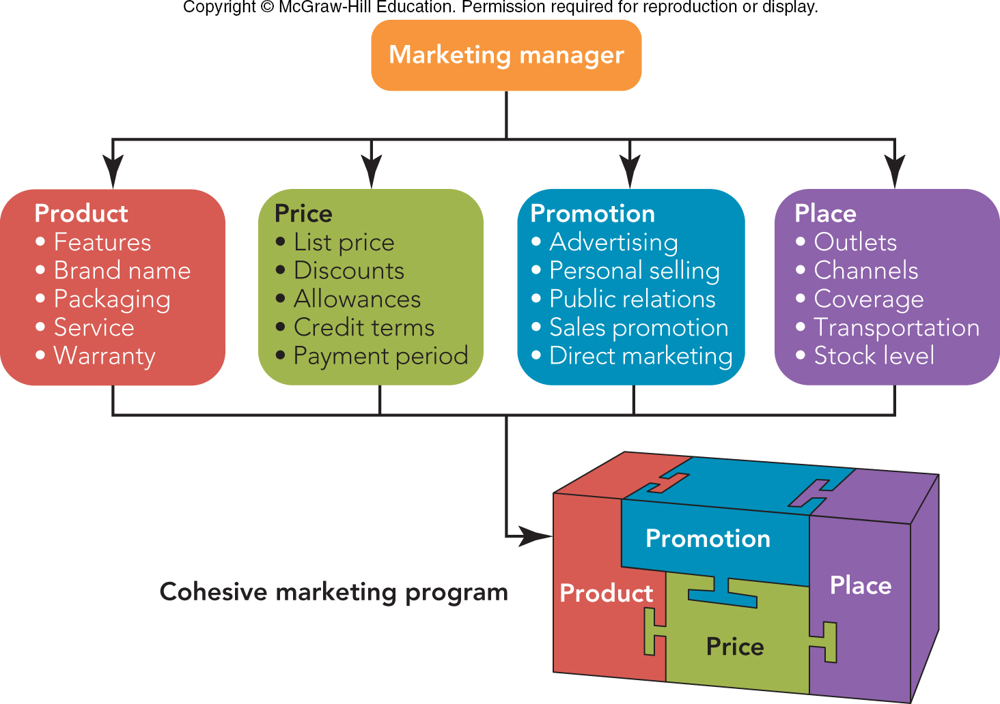
FIGURE 2-8 The four Ps elements of the marketing mix must be blended to produce a cohesive marketing program.
Jump to Appendix 8 long image description

Slide 33
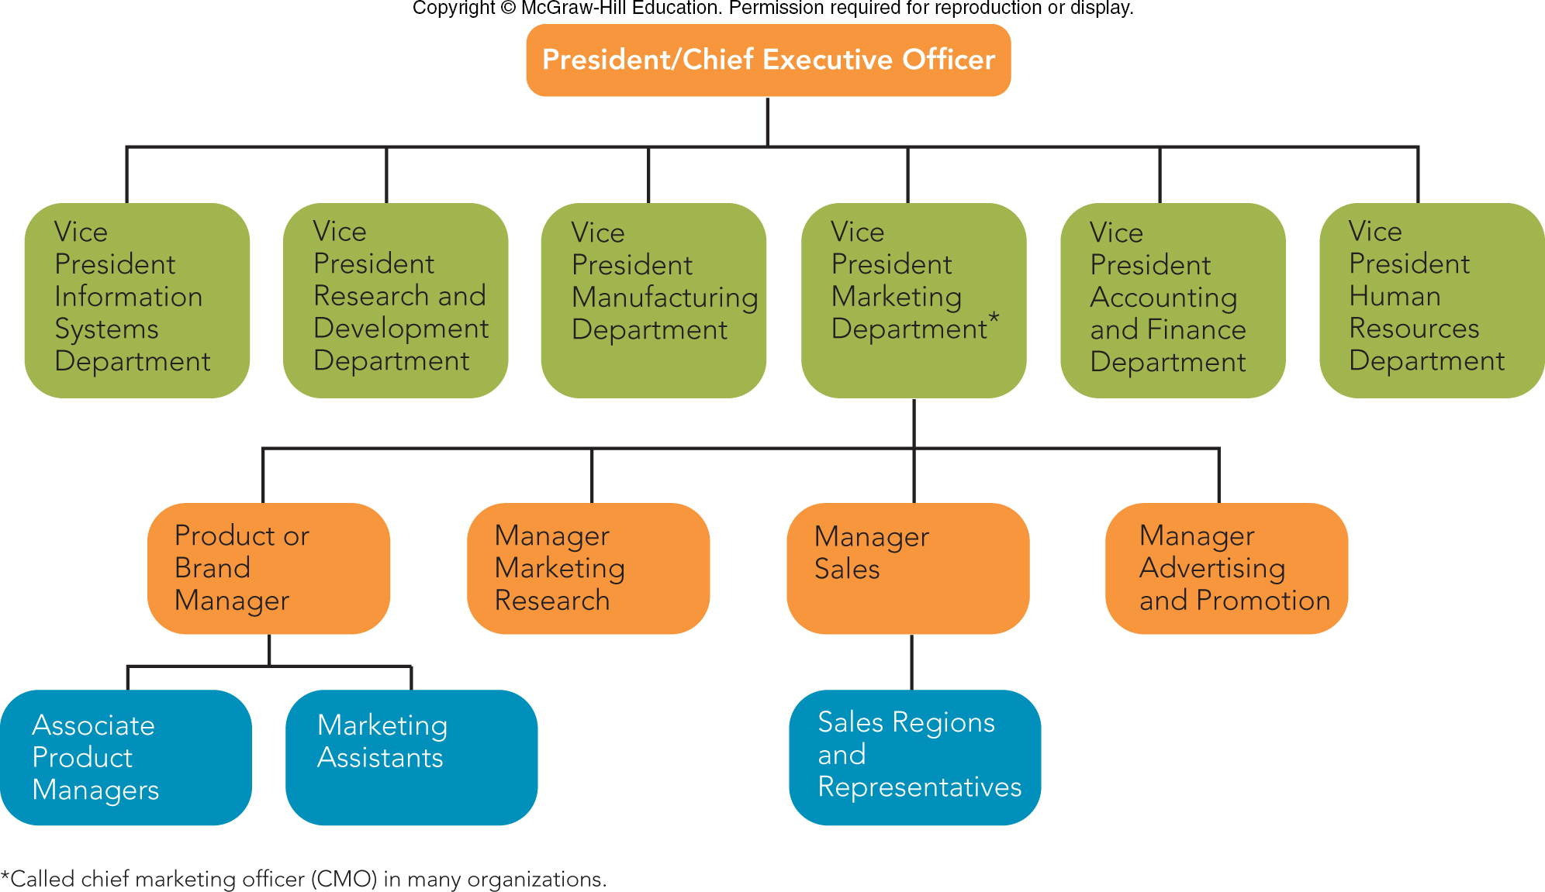
FIGURE 2-9 Organization of a typical manufacturing firm, showing a breakdown of the marketing department.
Jump to Appendix 9 long image description

Slide 34
THE STRATEGIC MARKETING PROCESS THE IMPLEMENTATION PHASE (2 of 2)
Defining Precise Tasks, Responsibilities, and Deadlines
Action Item List:
The Task
The Person Responsible for Task
Date to Finish Task
The Deliverable
Gantt Chart – Graph of a Program Schedule

Slide 35
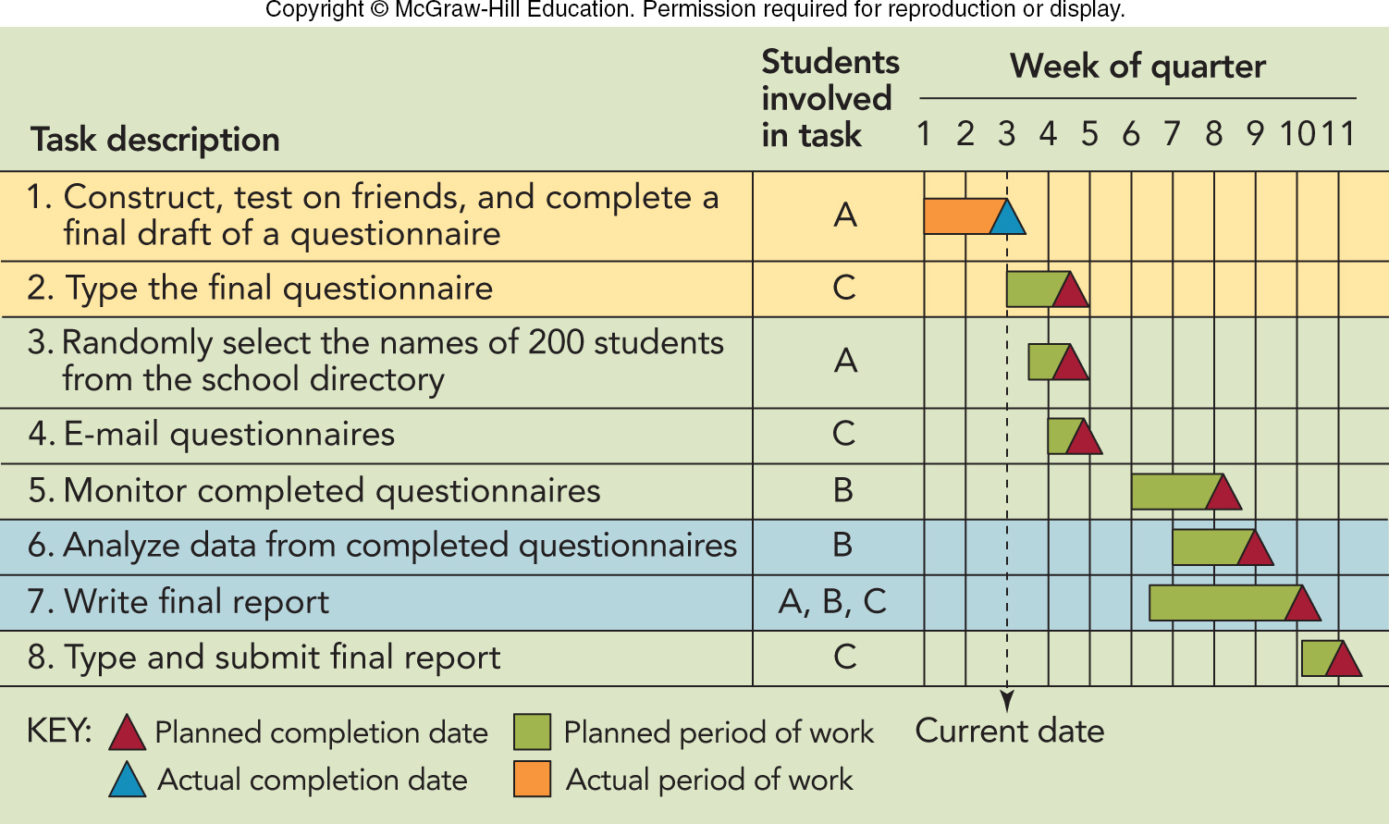
FIGURE 2-10 Gantt chart for scheduling a term project that distinguishes sequential and concurrent tasks.

Slide 36
THE STRATEGIC MARKETING PROCESS THE EVALUATION PHASE
Comparing Results with Plans (Forecasts) to Identify Deviations
Planning Gap
Acting on Deviations
Exploiting a Positive Deviation
Correcting a Negative Deviation

Slide 37
In Class Exercise
Selfridges, London UK
Set up a team of 4 students
Perform a SWOT analysis of Selfridges today
How will Selfridge continue to thrive in the Amazon world?
10 minutes, check in on your recommendations

Slide 38
SWOT Analysis - Selfridges
Location of Factor
Type of Factor
Favorable
Unfavorable
Strengths
Weaknesses
Internal
Opportunities
Threats
external

Slide 39
Announcements, Reading assignments for Monday class
Textbook - Chapter 3
Case Study, Inclusive Leadership: Mary Barra and General Motors
Office Hours on Mondays, 1:30 – 3:30 p.m. 2E108 Rady Undergraduate Offices

Slide 40
The Rady School of Management
MGT 103
Lecture #2
Sustainable Value Creation
11:00 – 12:20 p.m. Wednesday
January 8th, 2020

Slide 41
SWOT Analysis - Selfridges
Location of Factor
Type of Factor
Favorable
Unfavorable
Strengths
Weaknesses
Internal
Opportunities
Threats
external

